Slide 1
Northhwind Database Statistical Analysis
Akshay Ghalsasi
Flatiron Project 3

Slide 2
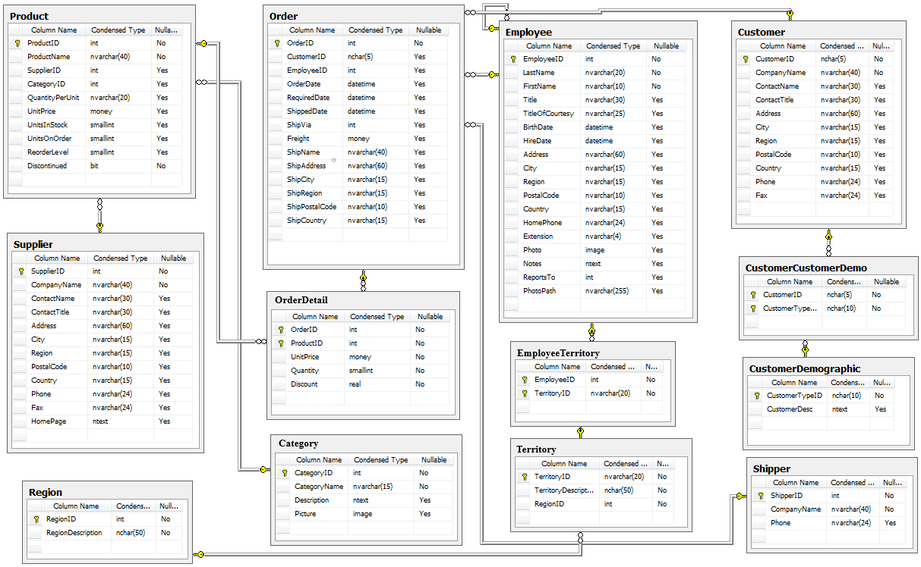
Data

Slide 3
Questions
Does discount amount have a statistically significant effect on the quantity of a product in an order? If so, at what level(s) of discount?
Do sales get better year on year? Does the month when the products were ordered matter?
Is there a standout employee in terms of the distribution from which quantities sold are drawn ? Are there employees who are shipping their orders significantly late?
Are there regions that are growing or decreasing in overall sales ? Are there product categories that are growing or decreasing in overall sales?

Slide 4
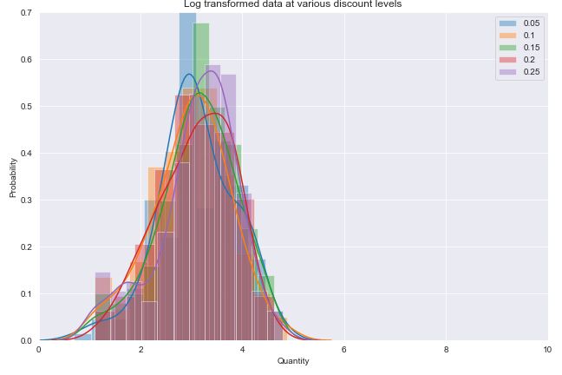
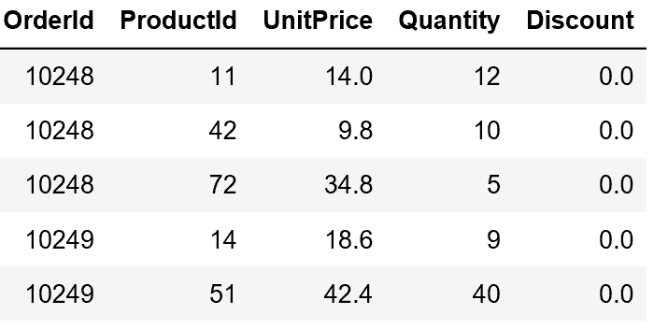
Q1
Does discount amount have a statistically significant effect on the quantity of a product in an order? If so, at what level(s) of discount?

Slide 5
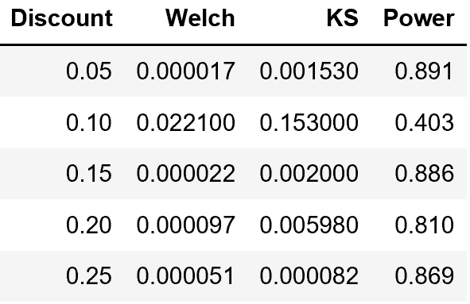
Q1 - Conclusions
Considering individual discount levels, discounted products at 0.05, 0.15, 0.2, and 0.25 levels are drawn from a a different distribution compared to the undiscounted quantities and have higher means. There is no concrete distinction in the distributions between 0.05, 0.15, 0.2 and 0.25 levels. 0.1 discount level needs to have more data points for us to potentially reject the null hypothesis
At the individual product level there is no evidence that discount levels matter, However that is most likely due to low statistics per product and per discount level.

Slide 6
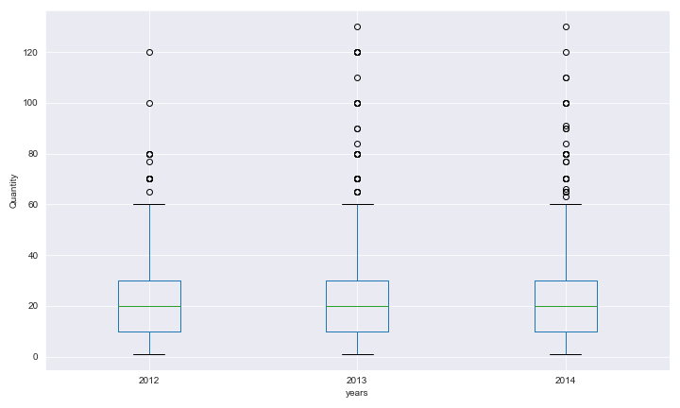
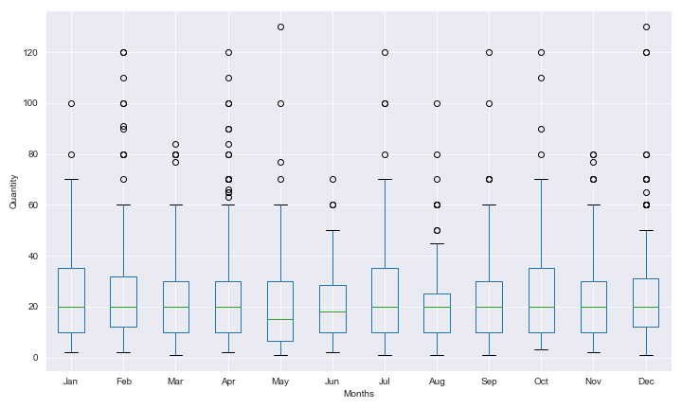
Q2
Do sales get drawn from a different distribution every year? Does the month when the products were ordered matter?

Slide 7
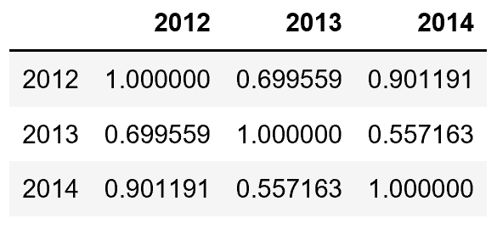
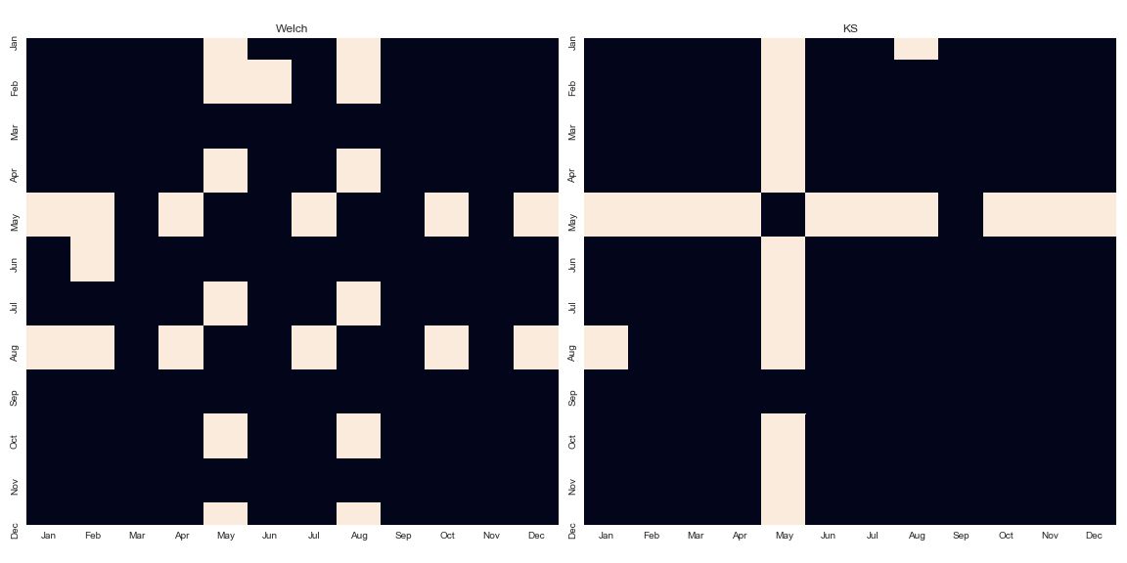
Q2-Conclusions
The sales do not seem to depend on year and the quantities seem to be drawn from the same underlying distribution.
For overall sales the month of May shows a definite decrease in quantities purchased

Slide 8

Q3 and Conclusions
Is there a standout employee in terms of the distribution from which quantities sold are drawn ? Are there employees who are shipping their orders significantly late?
Conclusions
There is insufficient evidence that the quantities sold between employees come from different distributions
Employees 2,4,7,9 statistically have a bad record of shipping on time compared to Employee 5

Slide 9
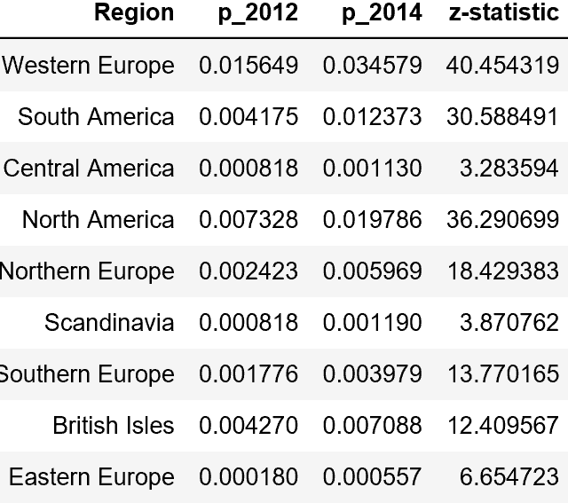
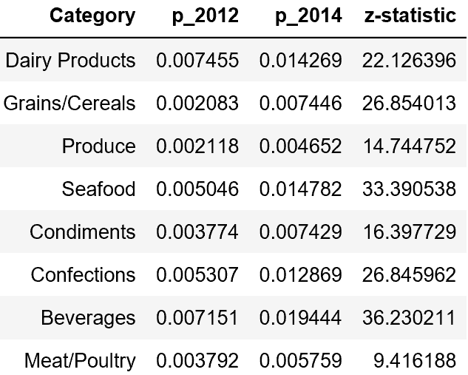
Q4 and Conclusions
Q4 Are there regions that are growing or decreasing in overall sales ? Are there products that are growing or decreasing in overall sales
Conclusions
All regions show a growth comparing year 2012 and 2014
All products show a growth comparing year 2012 and 2014

